Slide 1

Unit 8 Don't push, please

Slide 2

学习单词

Slide 3
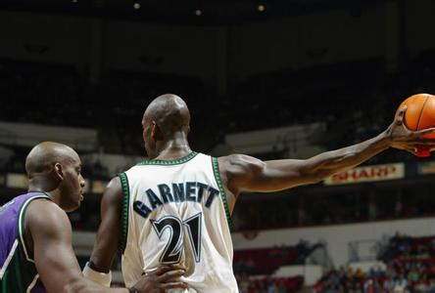
push 推

Slide 4
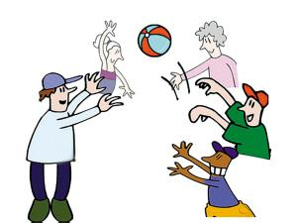
play 玩

Slide 5
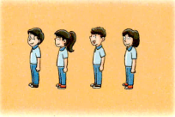
queue up 排队

Slide 6
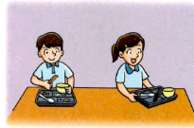
clean up 清洗

Slide 7
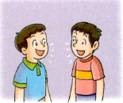
talk 谈话

Slide 8
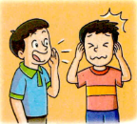
shout 吵闹

Slide 9

pass the ball

Slide 10

kick the ball

Slide 11
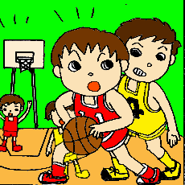
Don’t push.

Slide 12
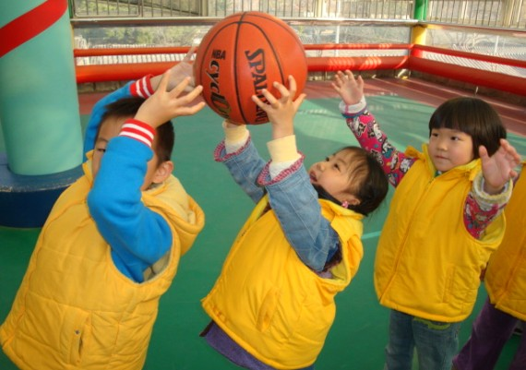
Queue up, please.

Slide 13
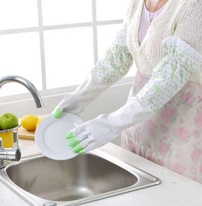
Clean up, please.

Slide 14

Don’t talk, please.

Slide 15
Homework
1.请同学们把今天学的对话读熟。
2.请把今天学的新短语写在作业本
上，每个写两遍。

Slide 16
Thanks for your attention!

